Slide 1
Satellite Communication

Slide 2
Space Craft Subsystem

Slide 3
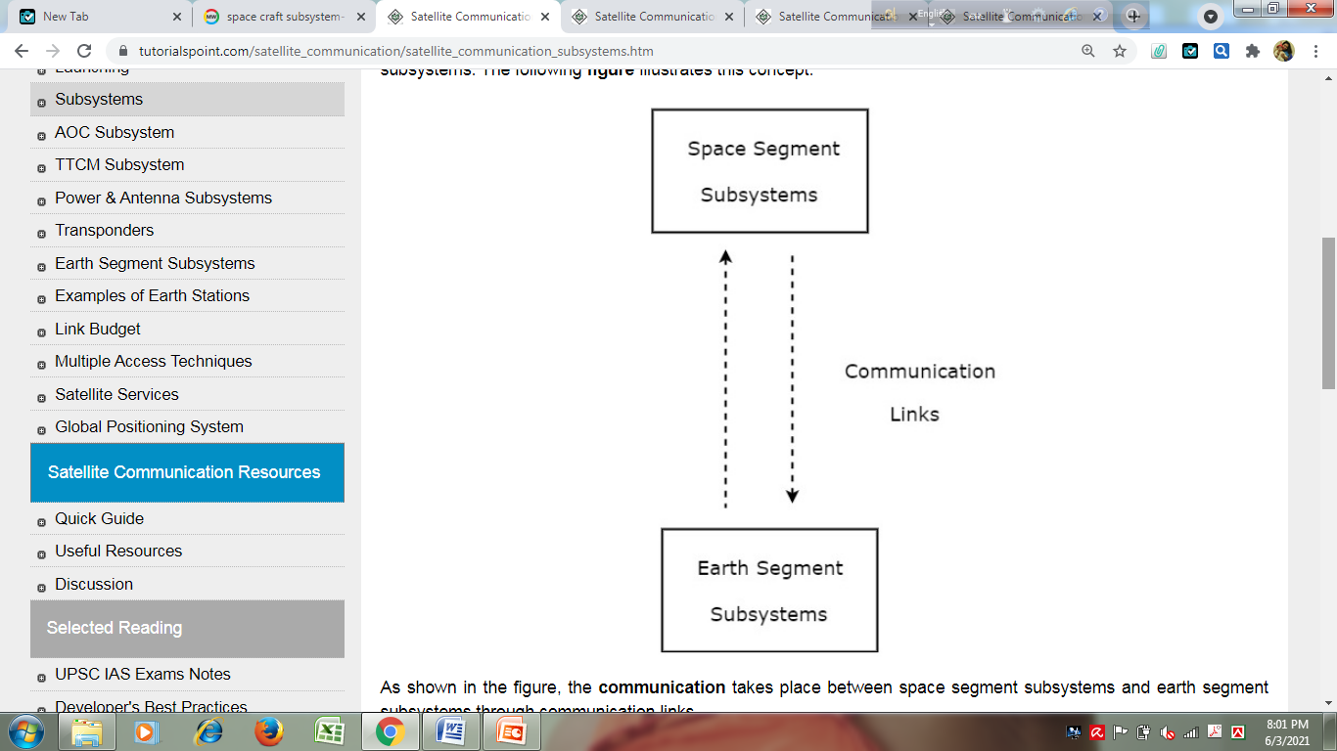
Space Segment Subsystems
The subsystems present in space segment are called as space segment subsystems. Following are the space segment subsystems.
AOC Subsystem
TTCM Subsystem
Power and Antenna Subsystems
Transponders

Slide 4
Altitude and Orbit Control (AOC)
Altitude and Orbit Control (AOC) subsystem consists of rocket motors, which are capable of placing the satellite into the right orbit, whenever it is deviated from the respective orbit.
It has following two parts.
Altitude Control Subsystem
Orbit Control Subsystem

Slide 5
Altitude Control Subsystem
Altitude control subsystem takes care of the orientation of satellite in its respective orbit. Following are the two methods to make the satellite that is present in an orbit as stable.
Spinning the satellite
Three axes method
Spinning the satellite
In this method, the body of the satellite rotates around its spin axis. In general, it can be rotated at 30 to 100 rpm in order to produce a force, which is of gyroscopic type. Due to this, the spin axis gets stabilized and the satellite will point in the same direction. Satellites are of this type are called as spinners.
Spinner contains a drum, which is of cylindrical shape. This drum is covered with solar cells. Power systems and rockets are present in this drum.

Slide 6
Altitude Control Subsystem
Communication subsystem is placed on top of the drum. An electric motor drives this communication system. The direction of this motor will be opposite to the rotation of satellite body, so that the antennas point towards earth. The satellites, which perform this kind of operation are called as de-spin.
During launching phase, the satellite spins when the small radial gas jets are operated. After this, the de-spin system operates in order to make the TTCM subsystem antennas point towards earth station.

Slide 7
Altitude Control Subsystem
Three Axis Method
In this method, we can stabilize the satellite by using one or more momentum wheels. This method is called as three-axis method. The advantage of this method is that the orientation of the satellite in three axes will be controlled and no need of rotating satellite’s main body.
In this method, the following three axes are considered.
Roll axis is considered in the direction in which the satellite moves in orbital plane.
Yaw axis is considered in the direction towards earth.
Pitch axis is considered in the direction, which is perpendicular to orbital plane.

Slide 8
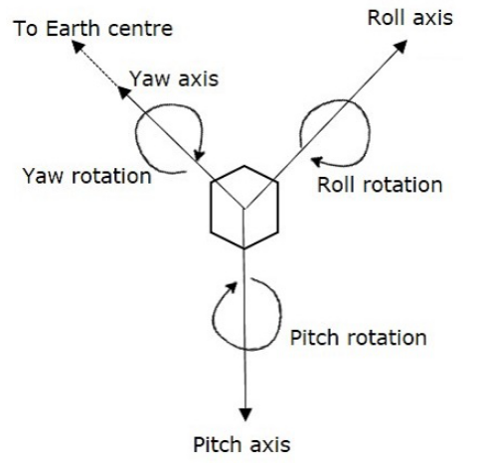

Slide 9
Altitude Control Subsystem
Let X_{R}, Y_{R} and Z_{R} are the roll axis, yaw axis and pitch axis respectively. These three axis are defined by considering the satellite’s position as reference. These three axes define the altitude of satellite.
Let X, Y and Z are another set of Cartesian axes. This set of three axis provides the information about orientation of the satellite with respect to reference axes. If there is a change in altitude of the satellite, then the angles between the respective axes will be changed.
In this method, each axis contains two gas jets. They will provide the rotation in both directions of the three axes.
The first gas jet will be operated for some period of time, when there is a requirement of satellite’s motion in a particular axis direction.
The second gas jet will be operated for same period of time, when the satellite reaches to the desired position. So, the second gas jet will stop the motion of satellite in that axis direction.

Slide 10
Orbit Control Subsystem
Orbit control subsystem is useful in order to bring the satellite into its correct orbit, whenever the satellite gets deviated from its orbit.
The TTCM (Telemetry, tracking, commanding and monitoring) subsystem present at earth station monitors the position of satellite. If there is any change in satellite orbit, then it sends a signal regarding the correction to Orbit control subsystem. Then, it will resolve that issue by bringing the satellite into the correct orbit.
In this way, the AOC subsystem takes care of the satellite position in the right orbit and at right altitude during entire life span of the satellite in space.

Slide 11
TTCM subsystem
Telemetry, Tracking, Commanding and Monitoring (TTCM) subsystem is present in both satellite and earth station. In general, satellite gets data through sensors. So, Telemetry subsystem present in the satellite sends this data to earth station(s). Therefore, TTCM subsystem is very much necessary for any communication satellite in order to operate it successfully.
It is the responsibility of satellite operator in order to control the satellite in its life time, after placing it in the proper orbit. This can be done with the help of TTCM subsystem.
It have following three parts.
Telemetry and Monitoring Subsystem
Tracking Subsystem
Commanding Subsystem

Slide 12
Telemetry and Monitoring Subsystem
The word ‘Telemetry’ means measurement at a distance. Mainly, the following operations take place in ‘Telemetry’.
Generation of an electrical signal, which is proportional to the quantity to be measured.
Encoding the electrical signal.
Transmitting this code to a far distance.
Telemetry subsystem present in the satellite performs mainly two functions −
receiving data from sensors
transmitting that data to an earth station.
Satellites have quite a few sensors to monitor different parameters such as pressure, temperature, status and etc. of various subsystems. In general, the telemetry data is transmitted as FSK or PSK.
Telemetry subsystem is a remote controlled system. It sends monitoring data from satellite to earth station. Generally, the telemetry signals carry the information related to altitude, environment and satellite.

Slide 13
Tracking Subsystem
Tracking subsystem is useful to know the position of the satellite and its current orbit. Satellite Control Center (SCC) monitors the working and status of space segment subsystems with the help of telemetry downlink. And, it controls those subsystems using command uplink.
We know that the tracking subsystem is also present in an earth station. It mainly focuses on range and look angles of satellite. There are number of techniques that are using in order to track the satellite. For example, change in the orbital position of satellite can be identified by using the data obtained from velocity and acceleration sensors that are present on satellite.
The tracking subsystem that is present in an earth station keeps tracking of satellite, when it is released from last stage of Launch vehicle. It performs the functions like, locating of satellite in initial orbit and transfer orbit.

Slide 14
Commanding Subsystem
Commanding subsystem is necessary in order to launch the satellite in an orbit and its working in that orbit. This subsystem adjusts the altitude and orbit of satellite, whenever there is a deviation in those values. It also controls the communication subsystem. This commanding subsystem is responsible for turning ON / OFF of other subsystems present in the satellite based on the data getting from telemetry and tracking subsystems.
In general, control codes are converted into command words. These command words are used to send in the form of TDM frames. Initially, the validity of command words is checked in the satellite. After this, these command words can be sent back to earth station. Here, these command words are checked once again.
If the earth station also receives the same (correct) command word, then it sends an execute instruction to satellite. So, it executes that command.
Functionality wise, the Telemetry subsystem and commanding subsystem are opposite to each other. Since, the first one transmits the satellite’s information to earth station and second one receives command signals from earth station.

Slide 15
Power Systems
We know that the satellite present in an orbit should be operated continuously during its life span. So, the satellite requires internal power in order to operate various electronic systems and communications payload that are present in it.
Power system is a vital subsystem, which provides the power required for working of a satellite. Mainly, the solar cells (or panels) and rechargeable batteries are used in these systems.
Two types of solar arrays: cylindrical solar arrays and rectangular solar arrays that are used in satellites. Rechargeable batteries produce power to other subsystems during launching of satellite. Generally these batteries charge due to excess current, which is generated by solar cells in the presence of sun light.

Slide 16
Antenna Subsystems
Antennas are present in both satellite and earth station.
Satellite antennas perform two types of functions. Those are receiving of signals, which are coming from earth station and transmitting signals to one or more earth stations based on the requirement. In other words, the satellite antennas receive uplink signals and transmit downlink signals.
We know that the length of satellite antennas is inversely proportional to the operating frequency. The operating frequency has to be increased in order to reduce the length of satellite antennas. Therefore, satellite antennas operate in the order of GHz frequencies. Four types of Antennas are used-
Wire Antennas (TTCM subsystem.)
Horn Antennas (used in satellites in order to cover more area on earth.)
Array Antennas (used in satellites to form multiple beams from single aperture.)
Reflector Antennas (for its high directivity it is used for transmit and receive signal)

Slide 17
Satellite link design
System noise temperature and G/T ratio
Downlink design
Uplink design (see satellite freq band)
Design of satellite links for specified C/N
Reference: https://www.slideshare.net/RAVIKIRANANANDE/satellite-link-design-107964430

Slide 18
System noise temperature and G/T ratio
The flux density and link equation can be used to calculate the power received by an earth station from a satellite transmitter with output power P_{t} watts and driving a lossless antenna with gain G_{t.}
the flux density in the direction of the antenna at a distance R meters is given by:
Φ (or F)=P_{t}G_{t} /4πR² [W/m² ]……….(1)
P_{t}G_{t} is called the Effective Isotropic Radiated Power or EIRP because an isotropic radiator with an equivalent power equal to P_{t}G_{t} would produce the same flux density in all directions.

Slide 19
System noise temperature and G/T ratio
For an ideal receiving antenna with an aperture area of A m² would collect a power of P_{r} watts given by
P_{r} =Φ×A
=P_{t}G_{t} A/4πR² [Watts]……(2)
The received ideal antenna gain is given by: G_{r}=4πA/λ² …..(3)
P_{r}=P_{t}G_{t} G_{r}/(4πR/λ)² [Watts] ….(4)
For a real antenna, however, the physical aperture area A_{r} , the effective aperture area A_{e} , and the aperture efficiency η_{A} are related by the equation
A_{e} =η_{A} A_{r} ……(5)

Slide 20
System noise temperature and G/T ratio
Power received by the real antenna with effective aperture A_{e} is
P_{r}=P_{t}G_{t}A_{e}/4πR² Watts…(6)
G_{r}=4πA_{e}/ λ² ……(7)
The link equation expressed in equation (4) further presented in equation (8) read as
Power received =(EIRP× Receive antenna gain)/ Path loss [Watts]…..(8)
Or, P_{r} =EIRP +G_{r} -L_{p} [dBW ]…..(9) [ideal case]
In practical case
P_{r} =EIRP +G_{r} -L_{p} -L_{a} -L_{ta} -L_{ra} [dBW ]…..(9)
Where, L_{a} =attenuation in atmosphere
L_{ta} =losses associated in Tx antenna
L_{ra} = losses associated in Rx antenna
Received power P_{r} is commonly referred to as carrier power C.

Slide 21
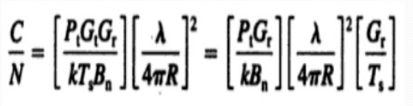
System noise temperature and G/T ratio
G/T ratio for earth station:

Slide 22
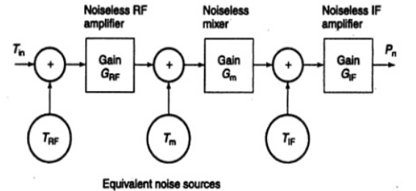
System noise temperature and G/T ratio
Total noise power at the output of IF amplifier of receiver
P_{n}=G_{IF}kT_{IF}B_{n}+G_{IF}G_{m}kT_{m}B_{n}+G_{IF}G_{m}G_{RF}kB_{n}(T_{RF}+T_{in})
P_{n}=G_{IF}G_{m}G_{RF}kT_{s}B_{n} (for single source of noise)
system noise temperature is T_{s}=[T_{in}+T_{RF}+T_{m}/G_{RF}+T_{IF}/(G_{m}G_{RF})]

Slide 23
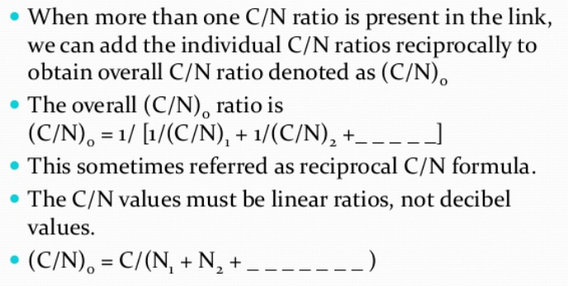
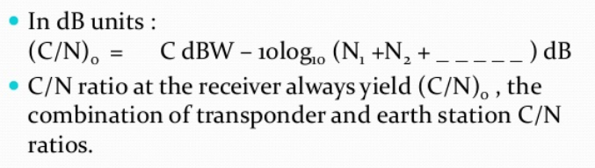
Design of satellite links for specified C/N

